Slide 1
StructTagger
Prepared by: Yousra Ashfaq
Supervised by : Thiriloganathan Murugan

Slide 2


Problem Statement
Manual process of tagging structural drawings is time consuming.
The job of drafting is relatively simple yet tedious
It requires two people to complete the process:
Manual Tagging- by an engineer
Tagging in AutoCAD- by a draughter

Slide 3
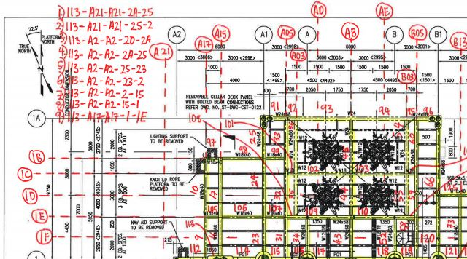
Manual Tags

Slide 4
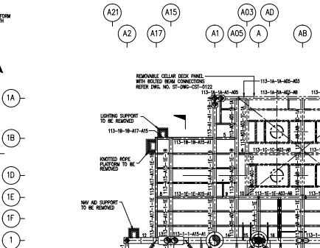
Tags in AutoCAD

Slide 5

Motivation Factor
Reduce the time spent on a repetitive task
Reduce the skill set required for a person to carry out the task

Slide 6

StructTagger!!!

Slide 7
Loading the tools into AutoCAD
There have been 2 separate programs created using the programming language “AutoLISP”
The first one, to draw the gridlines
The second, to create the tag names

Slide 8
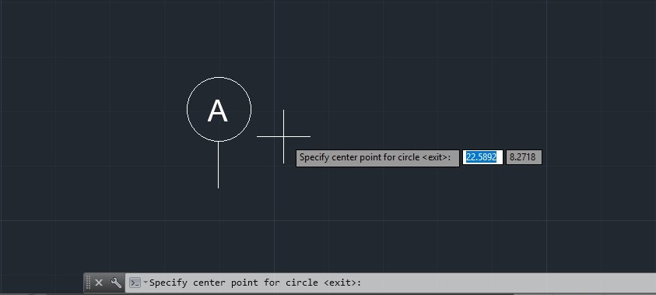
1. Drawing Gridlines

Slide 9
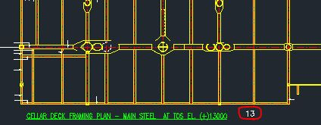
2. Creating Tag Names
Writing the Elevation Number

Slide 10
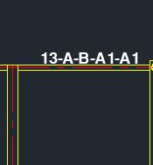
2. Creating Tag Names
Creating the Tags using StructTagger

Slide 11


Thank you for your time!

Slide 12
Thank you
Thiriloganathan Murugan
Thiriloganathan.Murugan@dnvgl.com

